Slide 1
MOLECULAR BIOLOGY LABORATORY
BT 453
Laboratory No. 2
RNA Extraction
MBL. BT453

Slide 2
OBJECTIVES
To explain and understand the basic principle of RNA extraction.
Understand why we isolate RNA
Know ways of inactivating RNases
Understand the basic principals in isolating total RNA and mRNA
MBL. BT453

Slide 3
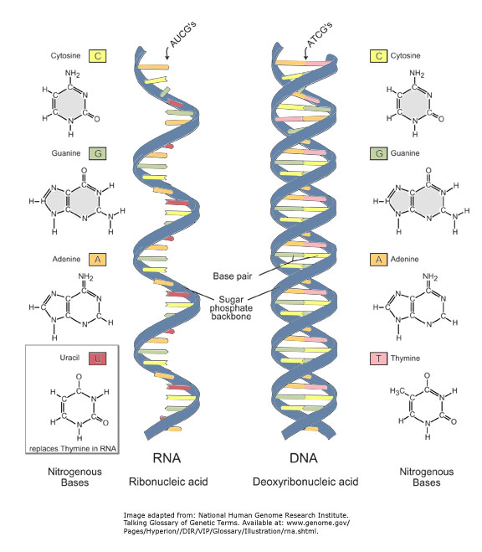
DNA vs RNA
http://data.gate2biotech.com/editor_images/rna_and_dna.jpg
MBL. BT453

Slide 4
Types of RNA
Three main types:
Messenger RNA (mRNA) – transfers DNA code to ribosomes for translation (2.5-5%).
Transfer RNA (tRNA) – brings amino acids to ribosomes for protein synthesis.
Ribosomal RNA (rRNA) – Ribosomes are made of rRNA and protein (~ 90%).
MBL. BT453

Slide 5
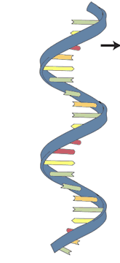
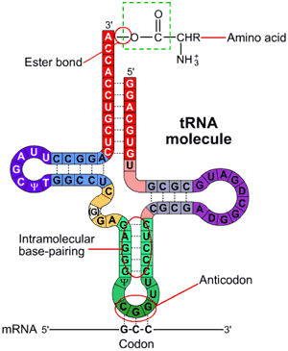
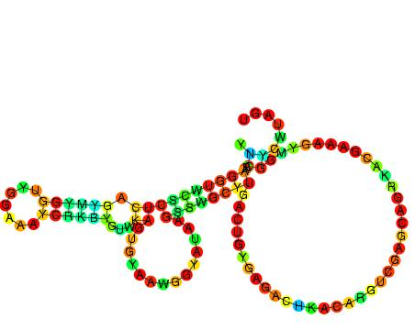
Types of RNA
mRNA
tRNA
http://data.gate2biotech.com/editor_images/rna_and_dna.jpg
16S rRNA
www3.interscience.wiley.com:8100/legacy/college/boyer/0471661791/structure/tRNA/trna_diagram.
http://en.wikipedia.org/wiki/23S_ribosomal_RNA
MBL. BT453

Slide 6
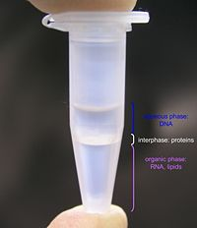
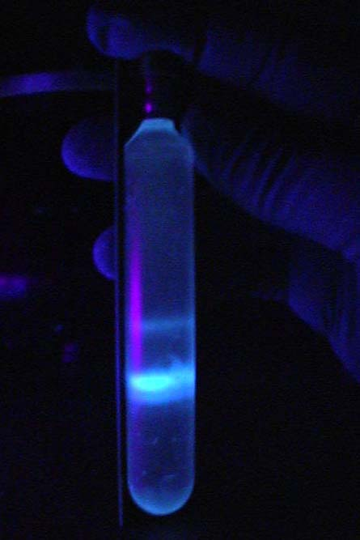
Types of Methods
Differential solubility
  Organic solvents
Adsorption methods
Density gradient centrifugation
openwetware.org/wiki/Phenol/chloroform_extraction
https://classshares.student.usp.ac.fj
MBL. BT453

Slide 7
Differential solubility / Organic solvents
DNA/RNA
HYDROPHILIC
RNA
Proteins/Crap
DNA
DNA
Proteins, lipids &
carbohydrates
HYDROPHOBIC
DNA
DNA
DNA
pH 7.9
pH 4.5
Phenol:Chloroform:IAA
1st Extraction
Acid-Phenol:Chloroform
2nd Extraction
MBL. BT453
MBL

Slide 8
Adsorption Technology
Cell lysis
Guanidine thiocyanate (Choatropic agent) denature proteins, solubilize lipid membrane and inactivate RNAses
Β-mercaptoethanol - denature proteins
A
Adsorption of RNA into silica membrane
Guanidine thiocyanate (Choatropic agent) dehydrate RNA forcing it to bind to the silica membrane, while other contaminants pass t hrough the column
Ethanol favours the binding of RNA into silica but not the DNA
Salt act as a cation bridge between the silica & the RNA
B
Washing of RNA
Guanidine thiocyanate (Choatropic agent)
Ethanol
Salt
C
D
RNA elution
RNAse-free water removes choatropic salt and sodium salt.
MBL. BT453
MBL. BT453

Slide 9



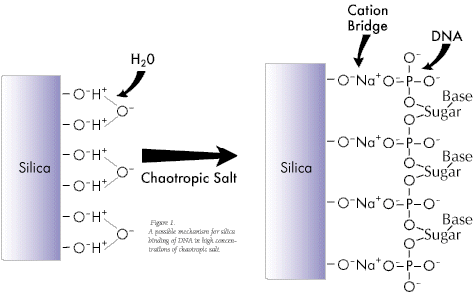
Adsorption Technology
Step A: Cell lysis
Step B: Adsorb to silica surface
Apply to column
Centrifuge
RNA
Silica-gel membrane
Extraction Buffer composition favors RNA adsorption to silica:
• Low pH
• High ionic strength
• Chaotropic salt
Flow through
(discard)
RNA bind to the membrane, while contaminants pass through the column.
RNA
Crude lysate containing nucleic acids and other cell constituents
Surface silanol groups are weakly acidic, and will repel nucleic acids at near neutral or high pH due to their negative charge
MBL. BT453

Slide 10
Adsorption Technology
Step C: Wash away residual contaminants
Centrifuge
Wash buffer
RNA
RNA
Step D: Elute nucleic acids
Flow through
(discard)
Centrifuge
Elution buffer
RNA
Elution Buffer composition is unfavorable to surface binding:
High pH
Low ionic strength
RNA
MBL. BT453

Slide 11
Messenger RNA Isolation
• mRNA molecules have a tail of A’s at the 3’ end
(polyA tail)
• Oligo(dT) probes can be used to purify mRNA
from other RNAs
• mRNA can be eluted from oligo(dT) matrix using
water or low-salt buffer

Slide 12
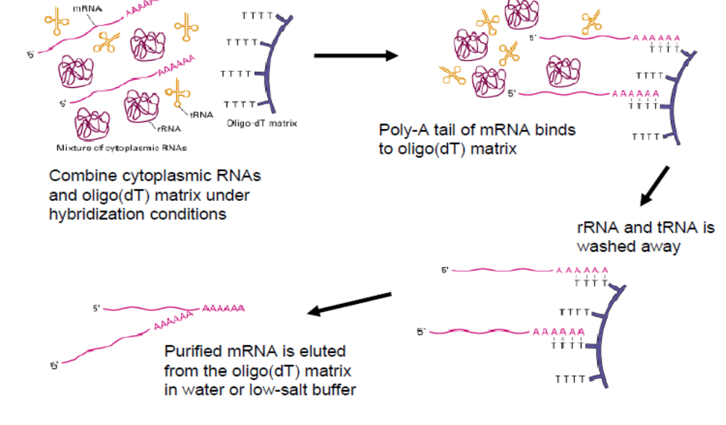
Messenger RNA Isolation

Slide 13

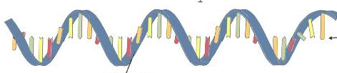
Problems
RNases
MBL. BT453

Slide 14
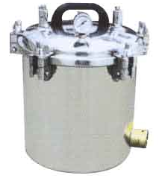
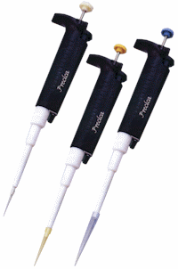
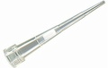
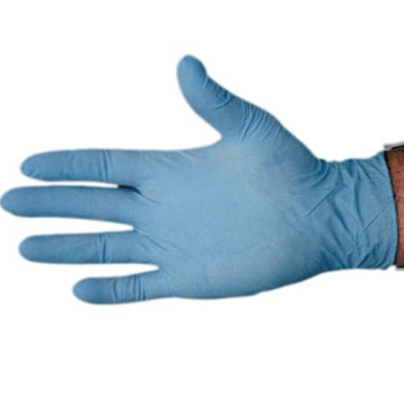

RNAses Control
Autoclave solutions. This is usually sufficient for getting rid of DNases, and most RNases as well.
Treat solutions with 0.1% DEPC. DEPC inactivates nucleases by covalently modifying the His residues in proteins. Generally considere unnecessary for DNA extraction. Not compatible with solutions containing Tris or HEPES.
Have a dedicated set of micropipettes or use aerosol barrier tips.
Wear gloves. You should be doing this anyway for safety reasons, but skin cells also produce RNase7, a potent RNA-degrading enzyme.
Bake glass, metal, or ceramic equipment at high temp
MBL
MBL. BT453

